Slide 1

Design of an Intelligent Energy Management System for a Hybrid Microgrid with Renewables and Battery Storage
Ntokozo Radebe (supervised by A/Prof Sunetra Chowdhury)

Slide 2
Content
Initial Situation
Load Data
System Components
Algorithm
Results
Conclusion

Slide 3
Initial situation:

Slide 4
Situation
Context
Design requirements
Global energy shift is creating a rising demand for sustainable, decentralized power systems.
Minimize cost of energy draw from the utility grid during grid-connected
Hybrid microgrids are a solution to this demand, combining renewable energy sources and traditional energy sources, able to operate both grid-connected and standalone.
Optimum use of solar PV and BESS as renewable energy sources
Ensure energy security during standalone mode
Intermittency of renewable generators (solar PV) create supply-demand imbalances
Ensure power quality at the load terminals in both operating modes
Need for intelligent energy management systems to ensure stability and cost efficiency arises

Slide 5
Literature Review
Algorithms reviewed
Algorithms used in the models studied:
Classical algorithms
Metaheuristic algorithms
Intelligent algorithms
Fuzzy logic
Artificial Neural Network
Deep Learning
Algorithms and their functions
Roles and priorities of the algorithms were:
Prioritize price
Prioritize sizing of microgrid
Ensure voltage control
Perform
Peak shaving
Curtailment

Slide 6
Load Data:

Slide 7
Data
Load Characteristics:
Load Characteristic | Energy (KWh)
Total | 4326
Average | 180
Maximum | 206.4
Minimum | 153

Slide 8
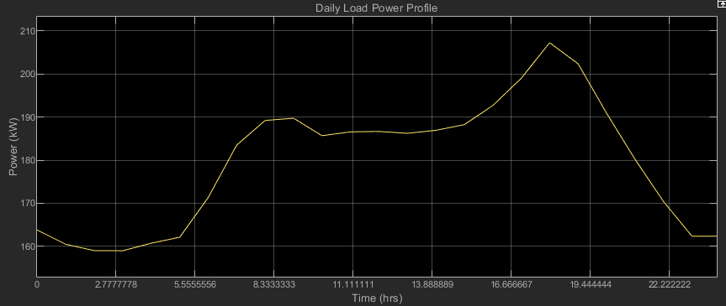
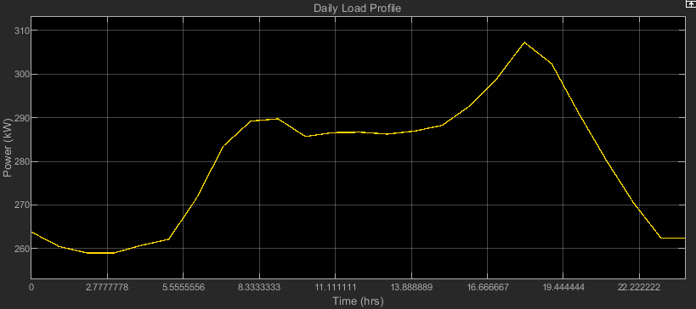
Load Profiles
Original sized load
Increased load (additional constant load)

Slide 9
System components:

Slide 10
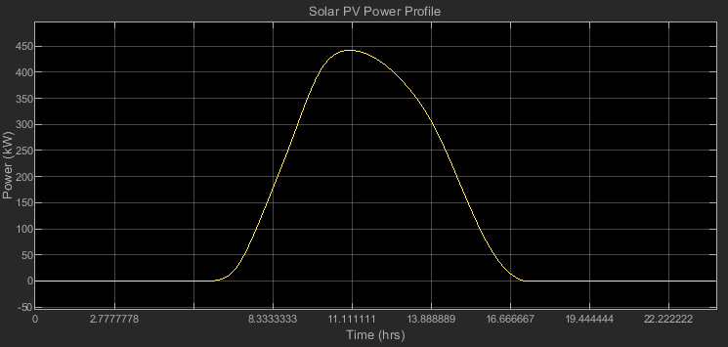

Solar Photovoltaic Panels (PV)
Key considerations
+ Use of NASA Power Data to obtain weather data
+ Radiance data and temperature data to calculate power losses (STC concept)
+ Area is 2000m^2, efficiency of panels is 18%
+ IEC 62548
+ Total size is 472.43 kW
Notes:
STC – Standard Test Condition
NOCT – Nominal Operating Cell Temperature

Slide 11
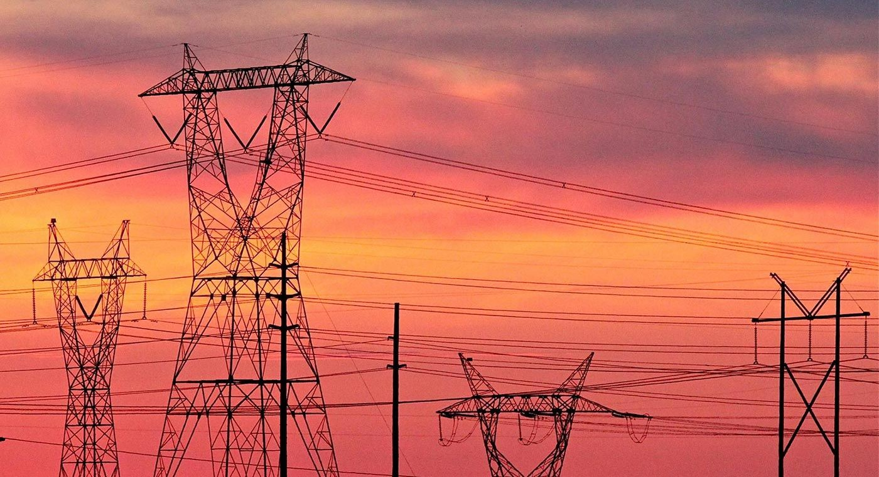
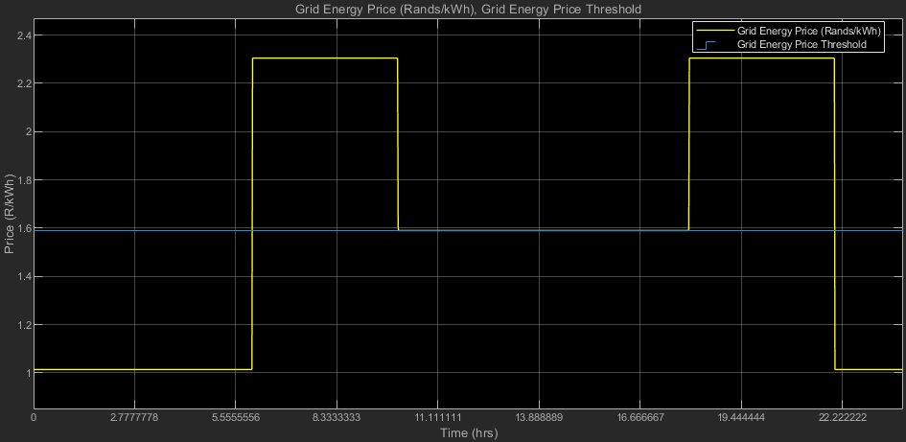
Utility grid
Key considerations
+ Use of utility grid based on low TOU tariff periods.
+ Sized to export maximum of 500 MW, with voltage of integration of 400 V.
+ IEEE1547

Slide 12
Battery Energy Storage System
+ Storage capacity is 3000kWh, terminal voltage 400V.
+ Min and Max SOC of 30% to 90% extend battery life
+ FLC IEMS integrated with the BESS to schedule charging and discharging commands.
+ Sized to be able to absorb all PV surplus power.
Minimum dis/charge time | 10 hours
Maximum power | 300 kW
Maximum SOC | 90%
Minimum SOC | 30%
Dis/charging efficiency | 95%
Battery inverter efficiency | 96%

Slide 13
The Algorithm:

Slide 14
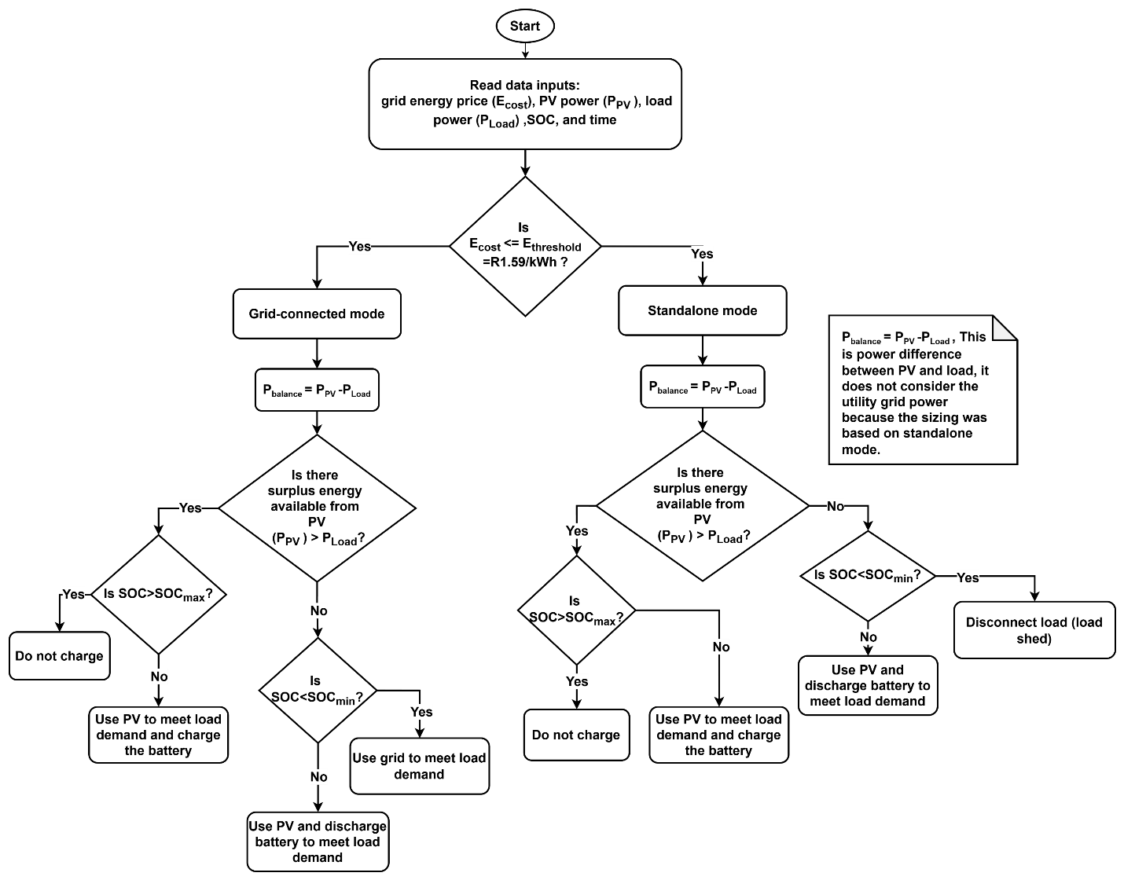
High level Flow Diagram

Slide 15
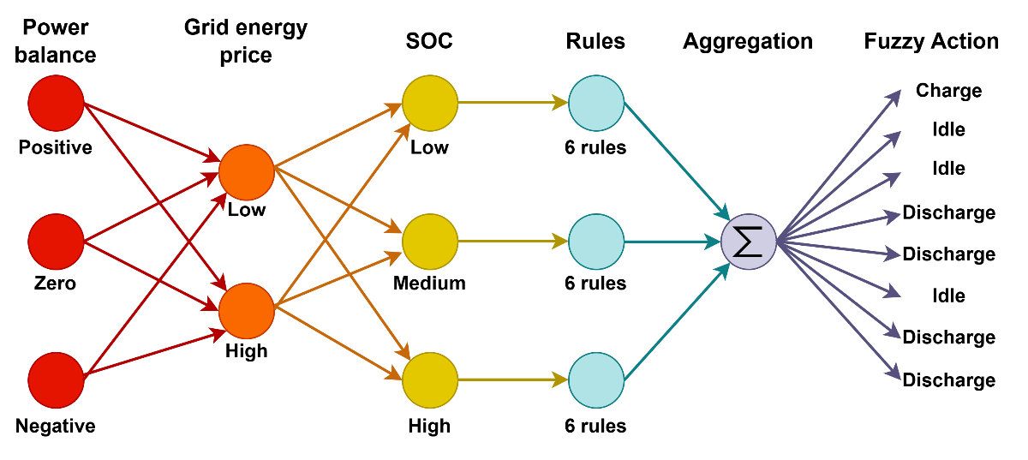
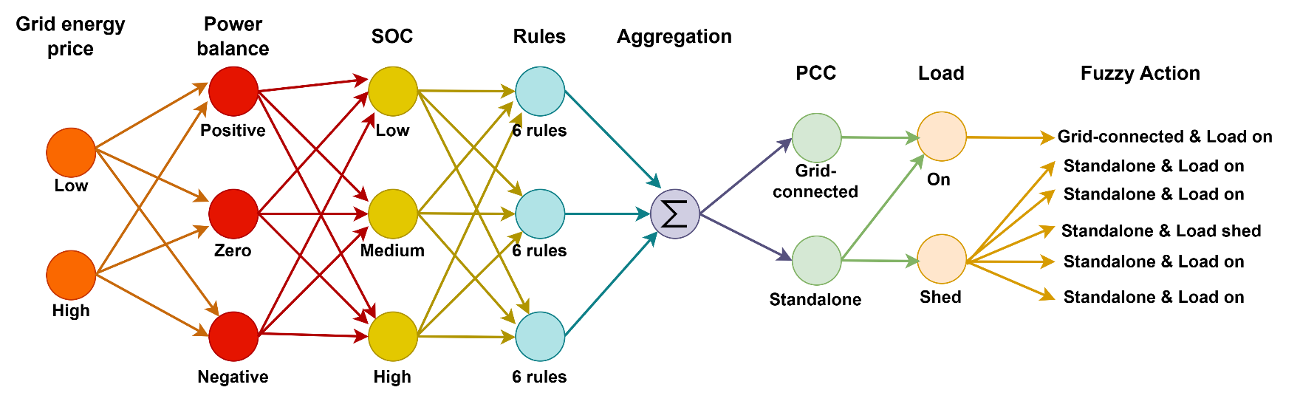
Fuzzy Logic
Mamdani FLC for BESS control
Controls the charging and discharging pattern
Sugeno FLC for mode and load control
Controls mode of operation and load connection

Slide 16
Integration:

Slide 17
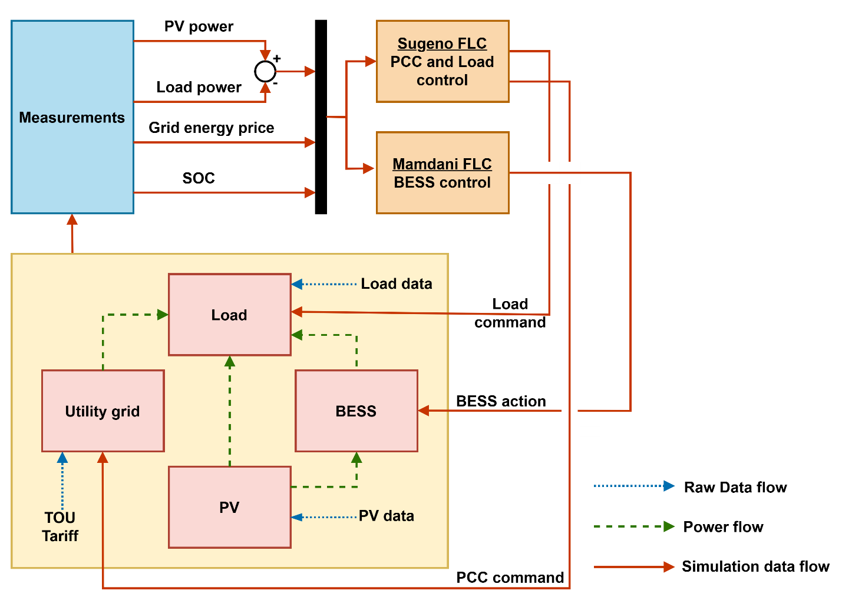
Microgrid with FLC IEMS

Slide 18
Results:

Slide 19
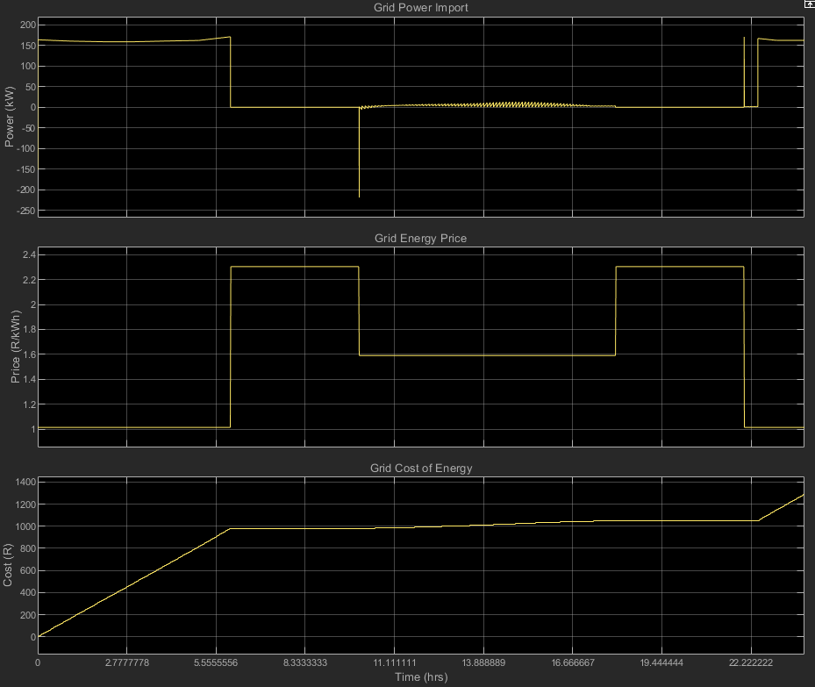
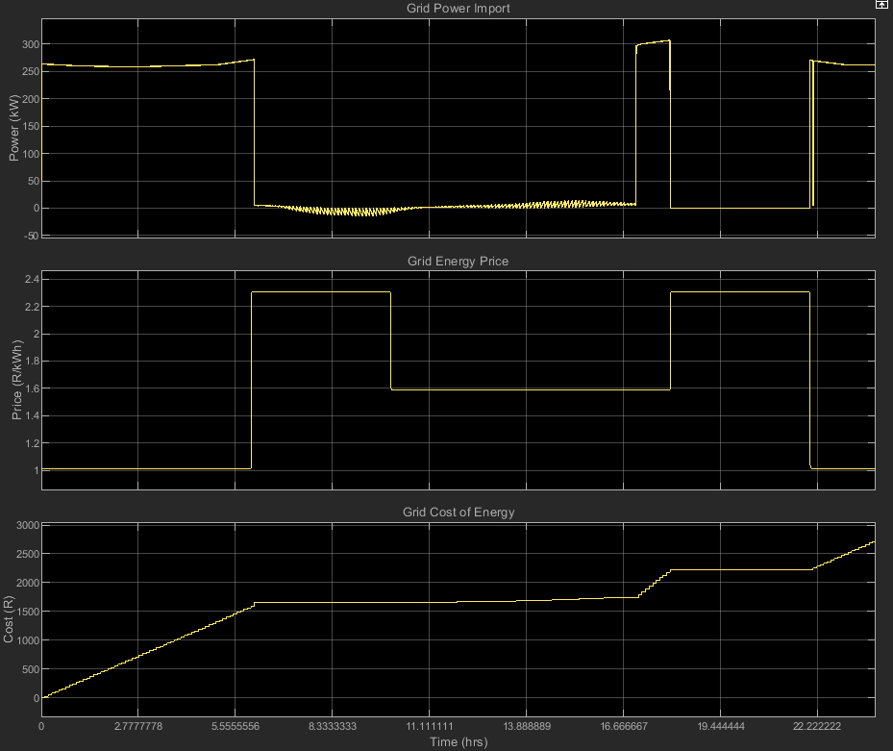
Simulation – Observations
Case 3 grid power, TOU tariff and grid cost of energy
Case 4 grid power, TOU tariff and grid cost of energy

Slide 20
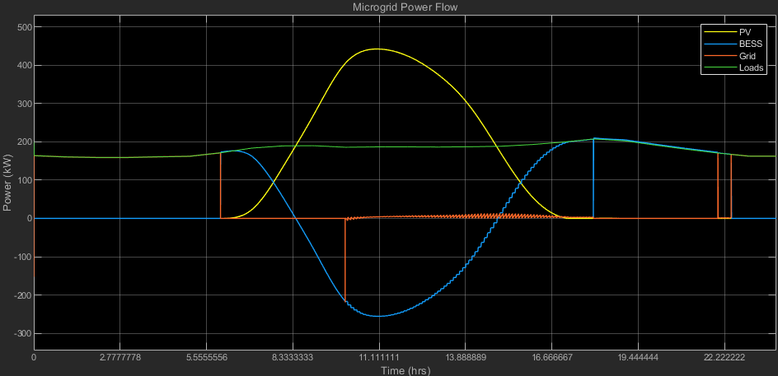
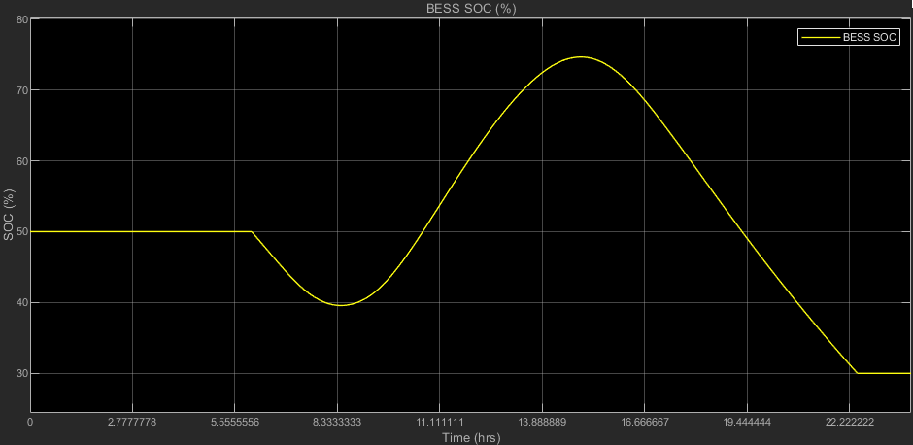
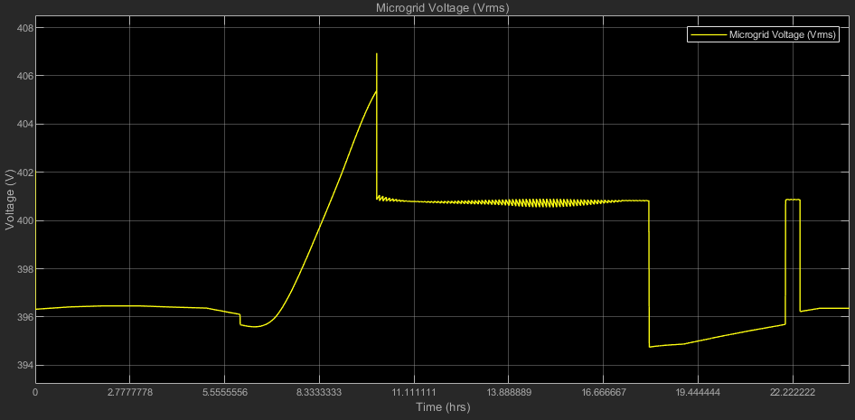
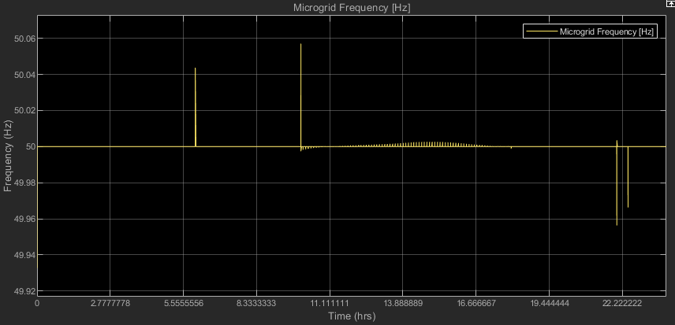
Simulation – Standard sized conditions

Slide 21
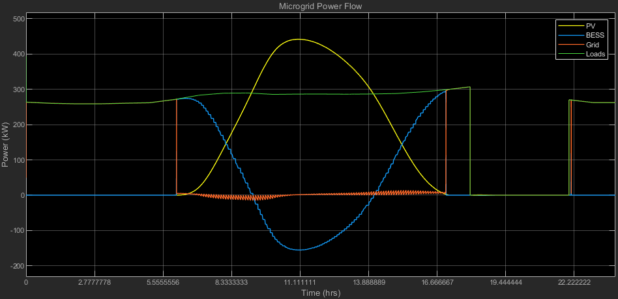
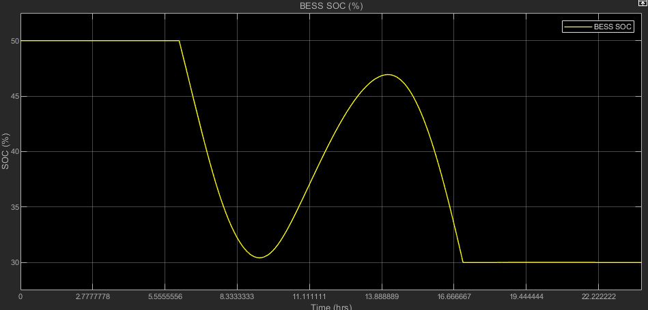
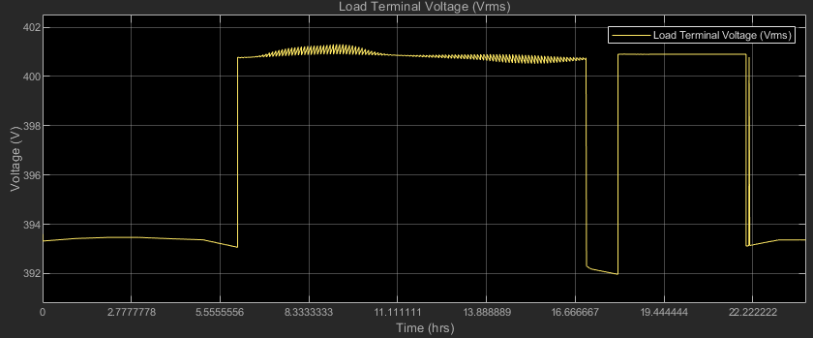
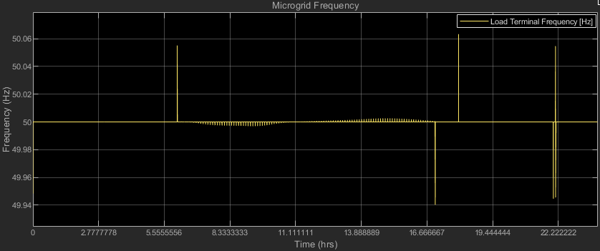
Simulation – Increased load

Slide 22
Results - Total Load Demand

Slide 23
Results - Total Cost of Energy
+ Highest cost of energy from the utility grid was R4437.00, due to no FLC IEMS and BESS integration.
+ Best case of R1312.00 was achieved for the CoE due to implemented FLC IEMS with BESS.

Slide 24
Conclusion:

Slide 25
+ Relevant since the power systems had more than 1 resource
Key takeaways, the FLC IEMS was…
+ Necessary with hybrid renewable energy systems
+ Used for cost reduction and satisfying demand by ensuring optimum use of DERs
+ Diﬀerent strategies for controls functions
+ Ensure the power quality at the load terminals by ensuring minimal frequency fluctuations and voltage fluctuations doing DER power flow

Slide 26
THANK YOU!

